Slide 1

Understanding the Software Development Life Cycle
An overview of SDLC for everyone involved
Notes:
AI-generated content may be incorrect. --- This presentation aims to provide a clear understanding of the Software Development Life Cycle (SDLC) for non-technical personnel. We will explore each phase of the SDLC and discuss the significant role that non-technical team members play throughout the process. Image source: Microsoft 365 content library

Slide 2

Agenda Items
Introduction to the Software Development Life Cycle (SDLC)
Phase 1: Requirements Gathering and Analysis
Phase 2: Design and Impact Analysis
Phase 3: Detailed Design and Technical Refinement
Phase 4: Development and Estimation
Phase 5: Testing and Deployment
Phase 6: Production Release
Example: Planning for a Vacation
Notes:
--- We will begin with an introduction to the SDLC, including its definition and importance. Then we will discuss each phase of the SDLC in detail, covering requirements gathering, design, development, testing, and deployment. Finally, we will relate these concepts to a practical example of planning a vacation. Image source: Microsoft 365 content library

Slide 3
Introduction to the Software Development Life Cycle (SDLC)
Notes:
The Software Development Life Cycle (SDLC) is a structured process used for developing software applications. Understanding SDLC is crucial as it ensures that software projects are completed efficiently, meeting user requirements and maintaining high quality.

Slide 4

Definition and Importance of SDLC
Stages of SDLC
SDLC outlines key stages in software development such as requirement analysis, design, implementation, testing, and maintenance.
Systematic Project Management
By following SDLC, teams can manage projects systematically, allowing for better coordination and resource allocation.
Risk Reduction
SDLC helps in reducing risks associated with software projects through careful planning and execution of each stage.
Notes:
--- SDLC defines the stages involved in software development. It is important because it provides a systematic approach to project management, ensuring timely delivery and reducing risks through careful planning and execution. Image source: Microsoft 365 content library

Slide 5
Stages of SDLC
Requirements Gathering
This stage focuses on understanding and documenting what users need from the software. It sets the foundation for the entire project.
Design
During the design phase, the system architecture and user interfaces are planned. This stage translates requirements into detailed specifications.
Development
The development stage involves coding and transforming design specifications into a functional software product.
Testing
In this phase, the software is rigorously tested for bugs and defects to ensure quality and performance meet the requirements.
Deployment
Deployment involves releasing the software to users. This stage ensures that it is accessible and functioning in the live environment.
Maintenance
The maintenance phase focuses on updating and improving the software post-deployment to fix issues and enhance functionality.
Notes:
The stages of SDLC typically include requirements gathering, design, development, testing, deployment, and maintenance. Each stage has specific tasks and objectives that contribute to the overall success of the project.

Slide 6

Role of Non-Technical Personnel in SDLC
Understanding User Needs
Non-technical personnel provide invaluable insights into user needs, helping to shape the product effectively.
Facilitating Communication
They facilitate communication among teams, ensuring a smooth flow of information throughout the SDLC.
Aligning with Business Goals
Non-technical personnel ensure that the final product aligns with business goals and user expectations.
Notes:
--- Non-technical personnel play a vital role in the SDLC, providing insights into user needs, facilitating communication among teams, and ensuring that the final product aligns with business goals and user expectations. Image source: Microsoft 365 content library

Slide 7
Phase 1: Requirements Gathering and Analysis
Notes:
This phase involves identifying the business needs and gathering the necessary requirements to inform the software development process. It lays the foundation for the entire project.

Slide 8

Identifying Business Needs
Define Project Goals
The first step is to clearly define the project's objectives to ensure successful outcomes.
Understand Business Needs
Understanding the specific needs of the business is essential for guiding the project direction effectively.
Ensure Alignment
Aligning the project with business goals ensures all stakeholders are on the same page for project success.
Notes:
--- The first step is to identify what the business intends to achieve with the software. Understanding these needs helps shape the direction of the project and ensures alignment with business goals. Image source: Microsoft 365 content library

Slide 9

Gathering Detailed Requirements
Functionalities Discussion
Discussing specific functionalities is crucial for understanding the needs of the end users.
Identifying User Roles
Identifying various user roles helps tailor the software to meet the different needs of each user group.
Workflow Processes
Mapping out workflow processes ensures that the software aligns with how users interact with it.
Notes:
--- Gathering detailed requirements involves discussing specific functionalities, user roles, and workflow processes. This helps create a clear blueprint of what the software should accomplish. Image source: Microsoft 365 content library

Slide 10

Analyzing Requirements
Feasibility Assessment
Analyzing requirements for feasibility ensures that the proposed solutions can be realistically implemented within constraints.
Completeness Check
A completeness check verifies that all necessary requirements are gathered and documented to avoid gaps in project execution.
Alignment with Objectives
Ensuring alignment with business objectives is crucial to maintain focus and deliver value throughout the project lifecycle.
Preventing Scope Creep
Analyzing requirements helps to identify potential scope creep, ensuring that the project stays within agreed boundaries.
Notes:
--- Once requirements are gathered, they must be analyzed to ensure they are feasible, complete, and aligned with the business objectives. This step is critical to avoid scope creep later in the project. Image source: Microsoft 365 content library

Slide 11
Phase 2: Design and Impact Analysis
Notes:
In this phase, the gathered requirements are transformed into a design that guides the development process. It also includes assessing the potential impacts of the proposed software.

Slide 12

Imparting Information to the Design Team
Effective Communication
Non-technical personnel need to communicate clearly to convey requirements and business goals effectively.
Aligning Design with Goals
Ensuring the design aligns with user expectations and project objectives is crucial for project success.
Notes:
--- Non-technical personnel must effectively communicate the requirements and business goals to the design team. This ensures that the design aligns with user expectations and project objectives. Image source: Microsoft 365 content library

Slide 13

Conducting Impact Analysis
Purpose of Impact Analysis
Impact analysis is essential for evaluating how proposed changes will influence current processes and systems.
Risk Mitigation
Understanding the impacts helps organizations mitigate risks associated with the implementation of changes.
Evaluating Existing Processes
Evaluating existing processes is critical to determine how they will be affected by proposed changes.
Notes:
--- Impact analysis evaluates how the proposed changes will affect existing processes and systems. Understanding these impacts helps to mitigate risks associated with implementation. Image source: Microsoft 365 content library

Slide 14
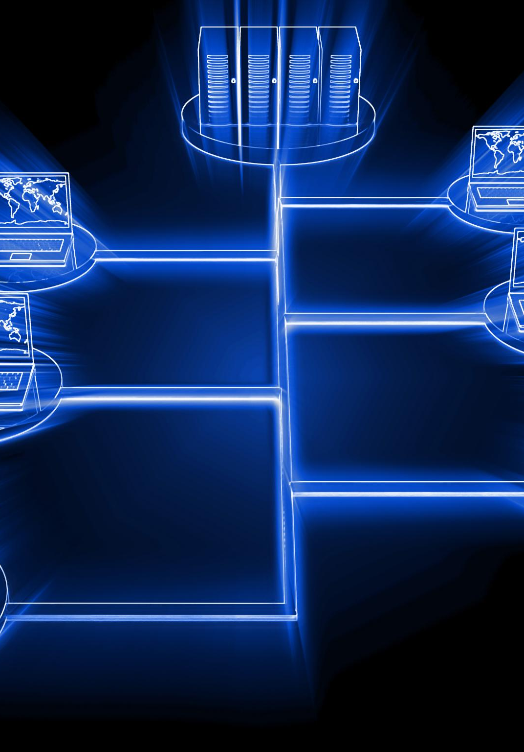
Creating High-Level Design
Software Architecture Overview
The high-level design provides an overview of the software architecture, detailing essential components and their interactions.
Modules and Interfaces
It defines the different modules of the software and how they interface with each other, ensuring seamless communication.
Data Flows
The design includes diagrams of data flows, highlighting how information is processed and transferred within the system.
Notes:
--- The high-level design outlines the architecture of the software, including modules, interfaces, and data flows. This serves as a roadmap for the development team. Image source: Microsoft 365 content library

Slide 15
Phase 3: Detailed Design and Technical Refinement
Notes:
This phase focuses on creating detailed designs for each module and refining technical specifications to prepare for the development stage.

Slide 16

Developing Low-Level Design
Detailed Specifications
Low-level design provides detailed specifications for each component, ensuring clear understanding and implementation.
Defining Algorithms
This phase involves defining algorithms that will dictate the logic and functionality of each component.
Data Structures
Choosing appropriate data structures is crucial for efficient data management and performance in software design.
Interfaces Definition
Defining interfaces establishes how different components will interact and communicate with each other.
Notes:
--- The low-level design breaks down the high-level design into detailed specifications for each component. This includes defining algorithms, data structures, and interfaces. Image source: Microsoft 365 content library

Slide 17

Technical Refinement for Development Team
Clarity in Tasks
Refining technical details helps the development team understand their specific tasks clearly, enhancing productivity.
Essential Tools
Identifying and refining the tools required for implementation ensures the team is well-equipped for the project.
Team Collaboration
Effective communication and collaboration within the team are crucial for successful technical refinement.
Notes:
--- It is essential to refine the technical details to ensure the development team has a clear understanding of their tasks and the tools required for implementation. Image source: Microsoft 365 content library

Slide 18

Technical Breakdown of Requirements
Clear Specifications
Having clear specifications helps in understanding the requirements and expectations of the software project.
Reducing Ambiguity
A comprehensive breakdown reduces ambiguity, helping developers to avoid misunderstandings and errors during development.
Successful Development
Well-defined requirements lay the foundation for a successful development process, leading to better outcomes and satisfaction.
Notes:
--- A thorough technical breakdown of requirements ensures that every aspect of the software is well-defined, reducing ambiguity and paving the way for successful development. Image source: Microsoft 365 content library

Slide 19
Phase 4: Development and Estimation
Notes:
During this phase, the actual coding takes place. The development team builds the software according to the specifications outlined in the design phases.

Slide 20

Estimating Development Effort
Resource Determination
Identifying the necessary resources is crucial for successful project execution and management.
Time Management
Accurate time estimation is essential for setting realistic deadlines and maintaining project schedules.
Budget Planning
Estimating the budget helps in financial planning and ensures that costs do not exceed limits.
Notes:
--- Estimating the development effort involves determining the resources, time, and budget required to complete the project. This helps in effective project planning and resource allocation. Image source: Microsoft 365 content library

Slide 21

Development of Code
Coding Process
The coding process is where developers transform designs and specifications into functional software code.
Critical Phase
This phase is crucial as it marks the transition from design to actual product development.
Software Implementation
Implementation involves integrating the code, testing functionalities, and ensuring it meets the established requirements.
Notes:
--- The development team writes the actual code for the software, following the designs and specifications established earlier. This is the most critical phase where the product begins to take shape. Image source: Microsoft 365 content library

Slide 22
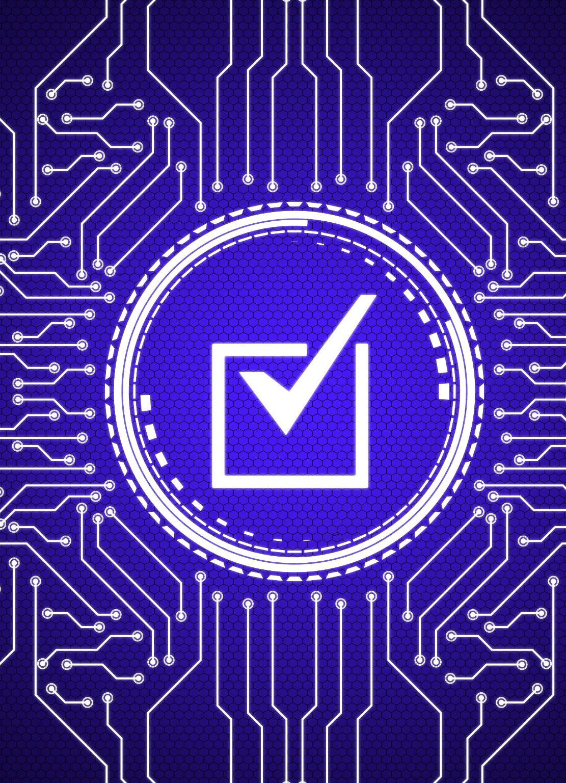
Unit Testing
Importance of Unit Testing
Unit testing is crucial for identifying bugs early in the development process, which can save time and resources later.
Component-Level Testing
Unit testing focuses on individual components of the software, ensuring that each part functions correctly before integration.
Prevention of Future Issues
By fixing issues during unit testing, developers can prevent larger problems that may arise during integration testing.
Notes:
--- After coding, unit testing is performed to identify and fix any bugs or issues at the individual component level. This helps ensure that each part of the software functions correctly before proceeding to further testing. Image source: Microsoft 365 content library

Slide 23
Phase 5: Testing and Deployment
Notes:
In this phase, the software undergoes various testing processes to ensure it meets the required standards and is ready for deployment.

Slide 24

Functional Testing
Purpose of Functional Testing
Functional testing aims to ensure software features operate as expected based on user requirements and specifications.
Types of Functional Tests
Different types of functional tests include unit testing, integration testing, and system testing to verify various aspects of software functionality.
Importance of Verification
Verifying features and functionalities helps identify issues early, ensuring that the software meets user needs and quality standards.
Notes:
--- Functional testing verifies that the software works according to specified requirements. This includes checking features and functionalities to ensure they meet user needs. Image source: Microsoft 365 content library

Slide 25

Regression Testing
Purpose of Regression Testing
Regression testing checks that new code changes do not disrupt existing features, ensuring software reliability.
Importance for Software Development
It is vital for maintaining software integrity and avoiding unintended side effects from updates.
Notes:
--- Regression testing ensures that recent changes or enhancements have not adversely affected existing functionality. This is vital for maintaining software integrity. Image source: Microsoft 365 content library

Slide 26

Deployment on Various Environments
Understanding Deployment
Deployment is the process of installing software across multiple environments tailored to organizational needs.
Production Environment
The production environment is where the software is live and accessed by end-users. It requires careful management to ensure stability.
Staging Environment
The staging environment mirrors the production setup, allowing for testing before deployment. It helps catch issues early.
Environment-Specific Configurations
Each environment may have unique configurations and requirements to optimize performance and security.
Notes:
--- Deployment involves installing the software in different environments (e.g., production, staging) based on the needs of the organization. Each environment may have specific configurations and requirements. Image source: Microsoft 365 content library

Slide 27
Phase 6: Production Release
Notes:
This phase marks the final release of the software into the production environment, making it available for users. It also includes support mechanisms to address any post-release issues.

Slide 28

Final Production Release
Milestone Achievement
The final production release marks a critical milestone in the software development lifecycle, indicating readiness for real-world application.
Completion of Testing
At this stage, all testing should be finalized, ensuring that the software is fully functional and bug-free.
System Stability
The software should be stable, providing users with a reliable and seamless experience upon release.
Notes:
--- The final production release is a significant milestone, indicating that the software is ready for actual use. At this point, all testing should be complete, and the system should be stable. Image source: Microsoft 365 content library

Slide 29

Post-Release Support
Monitoring Software Performance
Ongoing monitoring of software helps identify and address issues quickly, ensuring optimal performance for users.
User Assistance
Providing timely assistance to users helps resolve issues and maintain user satisfaction, contributing to a positive experience.
Ensuring Functionality
Post-release support ensures that the software remains functional and meets user needs over time.
Notes:
--- Post-release support involves monitoring the software for issues and providing assistance to users as needed. This ensures continued satisfaction and functionality. Image source: Microsoft 365 content library

Slide 30
Example: Planning for a Vacation
Notes:
To illustrate the SDLC, we can relate it to the process of planning a vacation. Each phase of the SDLC corresponds to steps in vacation planning, emphasizing the relevance of these concepts in everyday situations.

Slide 31
Gathering Requirements: Destination, Budget, Time
Choosing a Destination
Selecting the right destination is crucial for an enjoyable vacation experience, impacting activities and overall satisfaction.
Setting a Budget
Establishing a budget helps in managing expenses and ensures that your vacation aligns with your financial plans.
Determining Travel Dates
Identifying the best travel dates can affect availability, pricing, and overall experience during your trip.
Notes:
--- Just like in SDLC, the first step is gathering requirements for your vacation, such as choosing a destination, setting a budget, and determining the travel dates. This sets the foundation for planning. Image source: Microsoft 365 content library

Slide 32
Analyzing Options: Flights, Accommodations, Activities
Flights Analysis
Assess various flight options based on budget, duration, and layovers to find the best fit.
Accommodation Choices
Evaluate different types of accommodations, such as hotels, hostels, and vacation rentals for comfort and cost.
Activity Selection
Identify activities that align with travelers' interests and budget to enhance the overall experience.
Notes:
--- After gathering requirements, analyze options for flights, accommodations, and activities. This is similar to analyzing software requirements to ensure all aspects are considered. Image source: Microsoft 365 content library

Slide 33

Designing Itinerary: Day-to-Day Plans, Bookings
Daily Activity Scheduling
Creating a well-structured schedule for daily activities ensures a smooth flow throughout the trip.
Making Necessary Bookings
Timely bookings for accommodations, transportation, and activities are vital for a successful itinerary.
Design Phase in Itinerary Planning
Similar to the SDLC design phase, planning involves outlining objectives, resources, and constraints for travel.
Notes:
--- The next step involves creating a detailed itinerary, similar to the design phase in SDLC. This includes scheduling daily activities and making necessary bookings. Image source: Microsoft 365 content library

Slide 34

Refining Details: Packing Lists, Travel Documents
Creating Packing Lists
Creating a packing list helps ensure you don't forget any essential items for your trip.
Organizing Travel Documents
Organizing travel documents such as passports, tickets, and itineraries is crucial for smooth travel.
Refinement Process
Refining details before a trip is similar to the technical refinement phase in software development, ensuring everything is ready.
Notes:
--- As you prepare for your trip, refining details such as packing lists and ensuring all travel documents are in order is essential. This resembles the technical refinement phase in software development. Image source: Microsoft 365 content library

Slide 35

Execution: Departure, Daily Activities, Return
Departure Planning
The departure phase involves careful planning and preparation, similar to setting up a software deployment environment.
Daily Travel Activities
During the trip, daily activities mirror the ongoing operations of a software system, requiring flexibility and adaptation.
Return Journey
The return phase signifies the completion of the trip, akin to the software going live and completing its deployment cycle.
Notes:
--- Finally, the execution phase involves actually traveling. This parallels the development and deployment of the software, where plans come to fruition in real-time. Image source: Microsoft 365 content library

Slide 36
Conclusion
Importance of SDLC
Understanding the Software Development Life Cycle is crucial for non-technical personnel to enhance collaboration and communication.
Facilitating Collaboration
Effective collaboration leads to improved project outcomes and ensures that all team members are aligned in their goals.
Relatable Examples
Using everyday examples, like vacation planning, helps illustrate the principles of SDLC in familiar contexts.
Notes:
In conclusion, understanding the Software Development Life Cycle is essential for non-technical personnel as it facilitates effective collaboration and ensures project success. By relating it to everyday examples like vacation planning, we can see the relevance of these principles in various contexts.

